Slide 1
GMAPS
Collision Detection & Response

Slide 2
Part 2
Non-Axis-Aligned
Collision Response

Slide 3
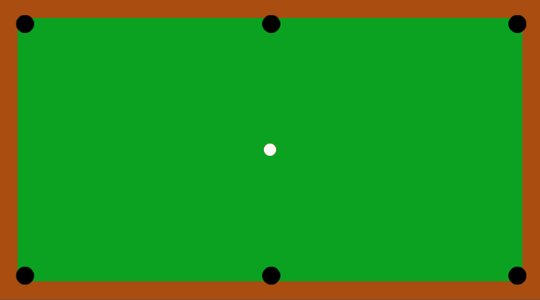
The concept is straightforward when the edges are aligned with the coordinate system axes, i.e. horizontal and vertical
But what if …

Slide 4
Not horizontal or vertical!
… the boundary edges are rotated?

Slide 5
Collision between two points

Slide 6
Collision between two points
This is straightforward!
distance
If the distance is ZERO or within a certain value, then there is a collision between the 2 points.
This “certain value” is defined by the programmer (threshold)

Slide 7
Collision between a point and a line

Slide 8
Collision between a point and a line
VectorC = VectorA - VectorB
VectorA
end
lineVec = end - start
VectorB = VectorA projected onto lineVec
start
What is the magnitude of VectorB?
Vector2.Dot(VectorA, lineVec.normalized)
Magnitude of VectorC is the distance of point from line!
What is the magnitude of VectorC?
Sqrt(VectorA.SqrMagnitude() - VectorB.SqrMagnitude())

Slide 9
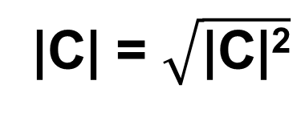
Collision between a point and a line
1) Find len C
A
C
top
B
top - bottom
bottom
Length of projection
(scalar, e.g. 10)
|A|²
- |B|²
→ |C|²
|C| = $\sqrt{\text{|}\text{C}\text{|2}}$

Slide 10


Collision between a point and a line
Not collided
Collided
If the distance from the line is 0 or within a threshold value, then the point has collided with the line.

Slide 11
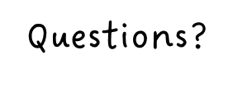

Slide 12
Now do Part 3 of GMAPS_Collisions_Worksheet.docx

